Slide 1
PRODUCT ADVERTISEMENT APPLICATION
PREPARED BY: MARY ALAKE OLAYINKA (CST20HND0272)
SUPERVISED BY: MR. ABUBAKAR MUHAMMED

Slide 2
Table of content
01. Background of the Study
02. Statement of the Problem
03. Aims and Objective of the Study
04. Significance of the Study
05. Summary of Literature Review
06. Research Methodology
07. System Modeling
08. Proposed Interface Design
09. Summary / Conclusion

Slide 3
Background of Study
The term mobile advertising refers to any form of advertising that appears on mobile devices such as smartphones and tablet computers. Companies advertise on these devices through text ads via SMS or through banner advertisements that appear embedded on a mobile website. They may also be found through downloaded apps including mobile games.
Modern technology has given consumers a wider range of options when it comes to how they consume media. In fact, people now spend more time on their smartphones, tablets and other mobile devices than they do sitting in front of the TV. ﻿ That's because of the ease and cost of these devices, not to mention the availability of wireless connections allowing people to tap in. In order to keep up with changing consumer habits, companies adapted their advertising campaigns by adopting mobile advertising strategies. That's because the chance that new and existing customers will see an ad through a mobile device is greater than they would through traditional avenues. Because mobile devices typically have smaller screens than computers or laptops, this form of digital advertising is usually optimized for small displays.

Slide 4
Understanding a customer base is why companies advertise their product but to gauge customer engagement with a product will require the customer understanding of the product and that’s portrayed through advertisements. Clients and customers engagement to a product is influenced by advertisement and with 2-Dimentional (2D) advertising customer are left to their imaginations to gauge the applicable areas of products and their usage which limit engagement but with 3-Dimentional (3D) or video streaming, products can be advertised through professional usage in their areas of application and method of usage
Statement of the Problem

Slide 5
Aim and Objectives of the Study
Aim
Objectives
By developing a social media platform application for posting advertisement, companies can engage user with creative content on how to use product in multiple ways. And also, how professionals handle said product
An engaging and easy to use UI with good UX using Flutter.
The logic will be handled and the data will be stored using Firebase.
Evaluating and verifying the app

Slide 6

Significance of Study
The platform or web app stands to benefit the industry with a choice of diverse advertising for different products and a way for customers to see how products are used (through model’s sampling) and their relevance thereby allowing customers to make better choice in choosing of product and brand

Slide 7
Summary of literature review
Title | Author & Year | Description | Merit | Demerits
An analysis of multimodal in beauty product advertisements. | Amatullah et al. (2019) | The focus of the study is on the comparison between verbal and visual elements used in two lipstick product advertisements, Wardah Lip Cream Matte Lipsticks and Purbasari Hi Matte Lip Cream. | it provided a deep understanding of the meaning of text in beauty product advertisements by using a multimodal analysis approach and comparing verbal and visual elements in two advertisements. | it is limited in scope as it only focuses on two lipstick product advertisements and may not be representative of all beauty product
Tree-based real-time advertisement recommendation system in online broadcasting | Kang et al. (2020) | The goal of this study is to overcome the limitations of traditional advertising services, which do not take into account user preferences. | The proposed recommendation system overcomes the limitations of traditional advertising services by taking into account user preferences. | It only focuses on the performance of the proposed system and does not compare it with existing recommendation systems, so it is unclear how it performs relative to other systems

Slide 8
Summary of literature review
Title | Author & Year | Description | Merit | Demerits
Design and implementation of the companion app. service for scene-based product advertisement | Lee et al. (2017) | This app aims to provide additional information and services related to the TV content being watched | The authors propose an architecture and schema for the companion app service and broadcasting program database, making the implementation process more streamlined. | The proposed design may not suit the needs of all users or TV content
Understanding the in-app advertisement effect on mobile user ad accessibility | Adikari, (2017) | This study aims to examine the effect of in-app advertising on mobile user behavior. The focus is on the ad features such as ad size, ad position, and ad vividness | it has provided a deeper understanding of the effect of in-app advertising | The system is limited to laboratory experimentation, which may not fully reflect real-world scenarios and user behavior.

Slide 9
Research Methodology
Choice of programming language
Method of data collection
Flutter
Dart
It is crucial to acquire data and facts about the current system before implementing any system since one has to understand what is happening. Two techniques were used to conduct this study.
Observation of the Work Environment
Interview

Slide 10
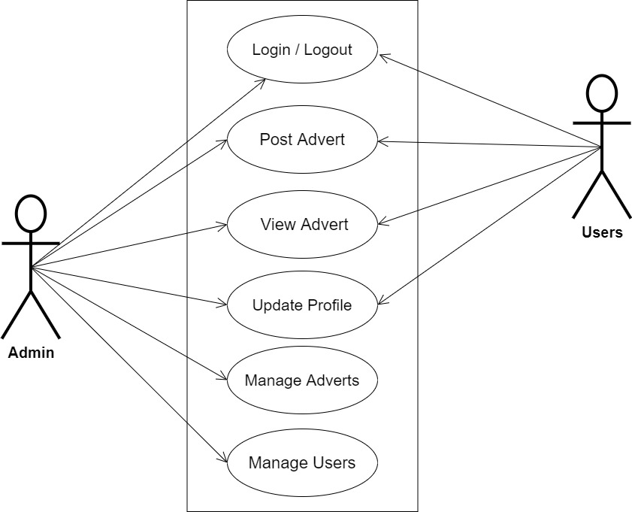
SYSTEM MODELING (USE CASE DIAGRAM)

Slide 11
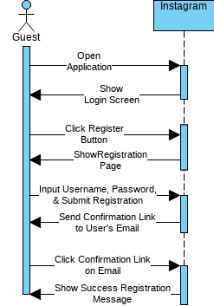
SYSTEM MODELING (SEQUENCE DIAGRAM)

Slide 12
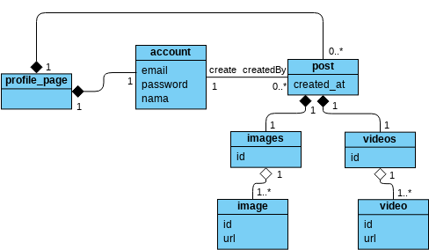
SYSTEM MODELING (CLASS DIAGRAM)

Slide 13
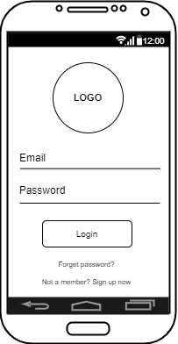
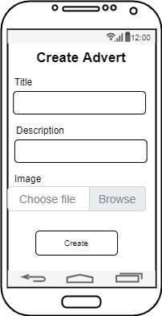
PROPOSED INTERFACE DESIGN
User login
Create Advert form

Slide 14
Summary & Conclusion
In conclusion, the system can help to streamline ways to use the products thereby reducing time in exploring best ways of using the product as well as allowing customers to make better choice in choosing of product and brand.

Slide 15

Thank you

